Slide 1


CINEA/EMFAF/2021/3.1.2/03/SC04/SI2.881222
Specific Contract 2021/3.1.2/03/SC04
Hosting, maintenance and further development of the Regional Database for the Mediterranean and Black Seas (RDBFIS II)
(RDBFIS-II, 01/04/2023 – 31/03/2025)
RCG LP
Larnaca, Cyprus 2nd - 4th of June 2025
Stefanos Kavadas, Irida Maina

Slide 2
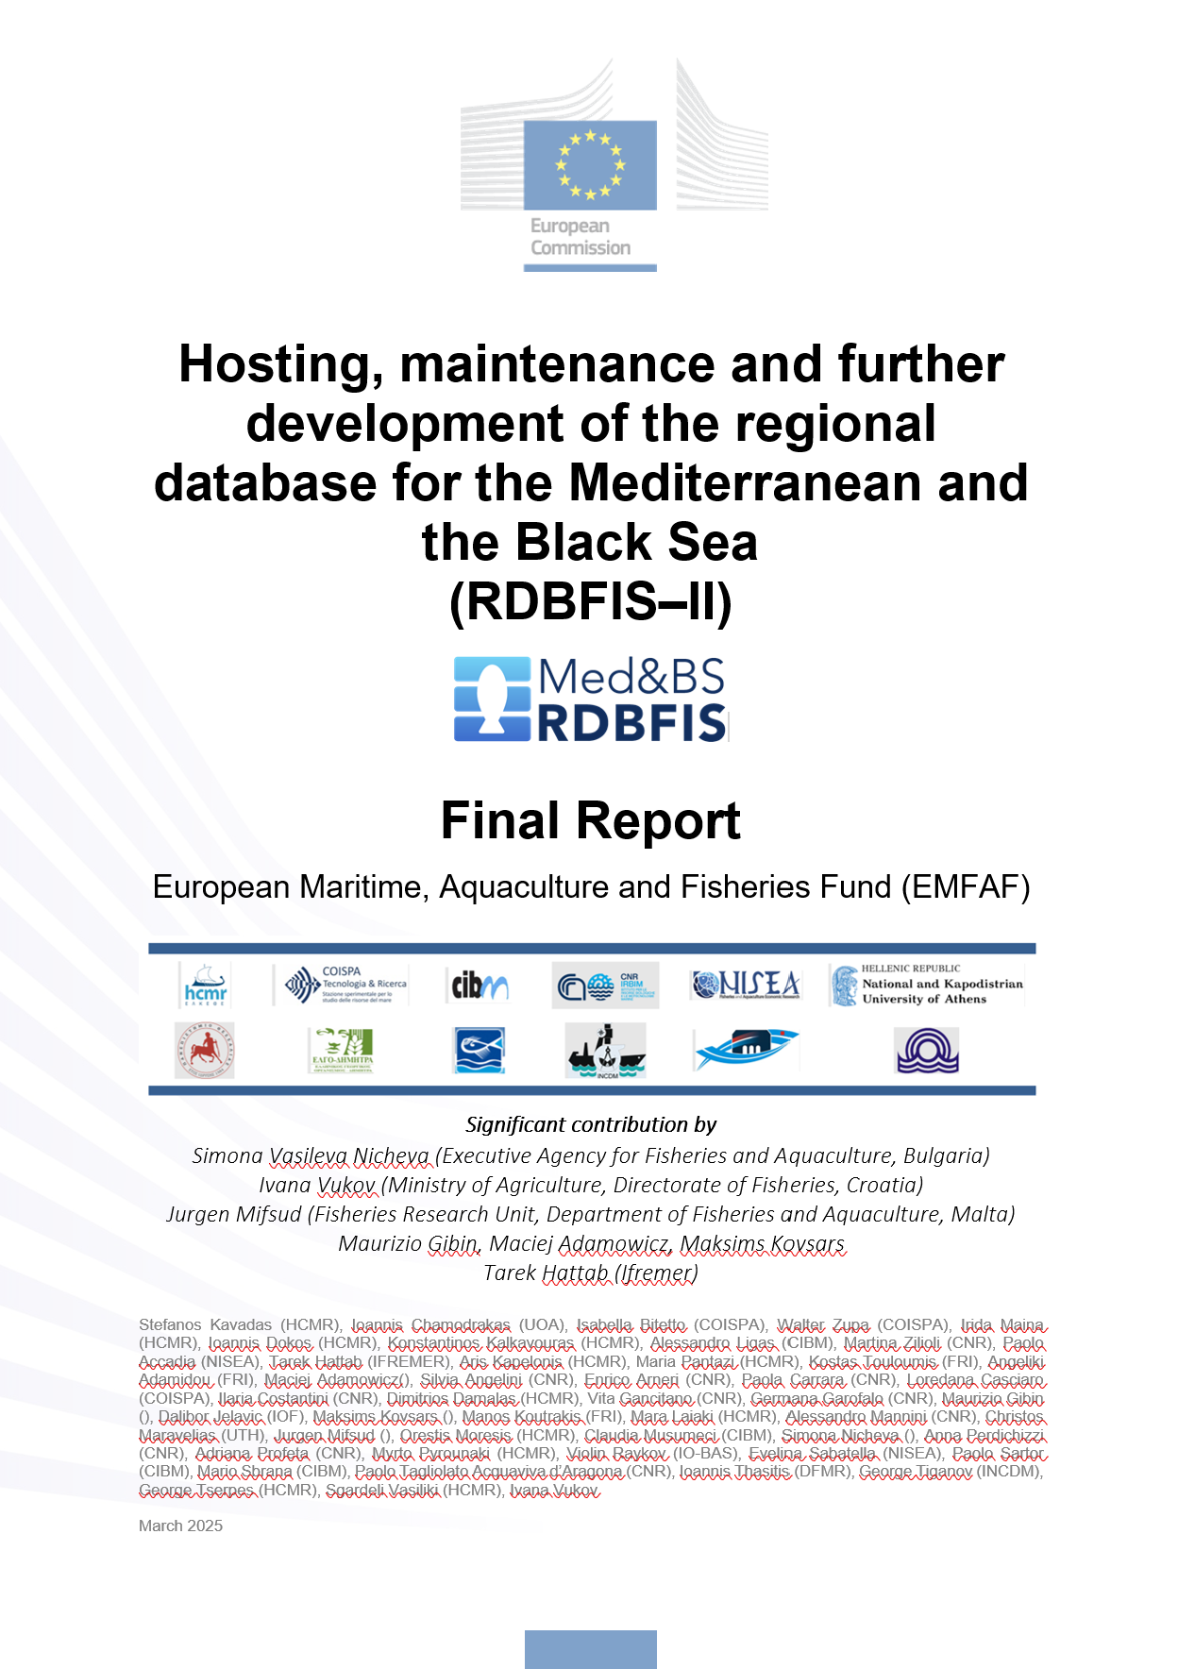
RDBFIS Final Report (draft)

Slide 3
RDBFIS progress work -> populate the system with data
1. Aggregated data
Med&BS
FDI (Tables A, B, G, H, I, J)
AER
GFCM/DCRF
2. Survey data
MEDITS (TA, TB, TC)
MEDIAS (acoustics, pelagic trawl, CTDs)
3. Detailed biological & landings data
A straight-forward process to upload data
Step 1. Syntax check (validation scheme)
csv
Step 2. Consistency check (quality control routines)
Step 3. Upload (update RDBFIS)

Slide 4


RDBFIS progress work -> surveys
MEDITS & MEDIAS integration within RDBFIS
1. MEDIAS database structure
Acoustics, Pelagic trawl, CTDs
2. Integration with RDBFIS
3. Validation scheme
4. Consistency check (R)
5. Processing (SQL)
Abundance, Biomass, Abundance-Biomass
6. Eggs & Larvae database structure
7. The MEDIAS data call is in progress,
Four workshops have been conducted
Integration & updated versions
1. RoME
2. RoMEBS
3. BioIndex integration
In the framework of the projects Qualitrain and RDBFIS, improvements were made on the R packages supporting the data quality and processing.
Within RDBFIS, the packages have been updated, replacing the older versions.

Slide 5

RDBFIS overview
Med&BS RDB
Med&BS, FDI & GFCM/DCRF datacalls
Detailed bio data
MEDITS, MEDIAS, Eggs&Larvae
Large Pelagic
EU Fleet
Stomach content
PETS, alien species, recreational
Coding
Environmental
Spatial data
Integrated Components
UI
Validation schemes
RDBqc
RDBprocessing
RoME, RoMEBS
BioIndex
EU fleet analysis
MCDA for SSF
FDI spatial checks
Mapping
Stomach content & Eggs&Larvae data entry forms

Slide 6
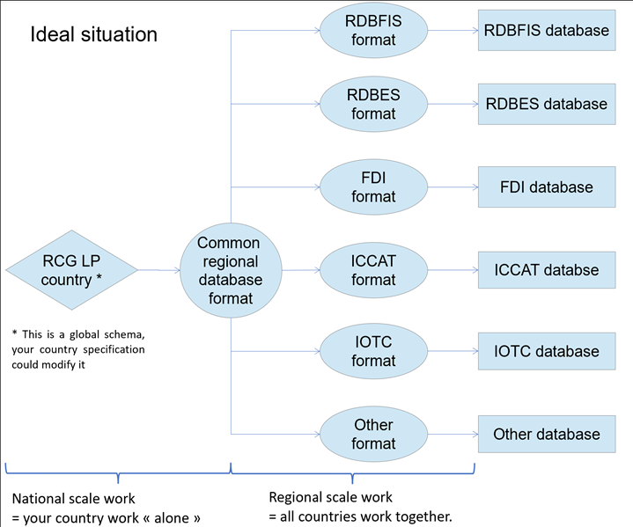
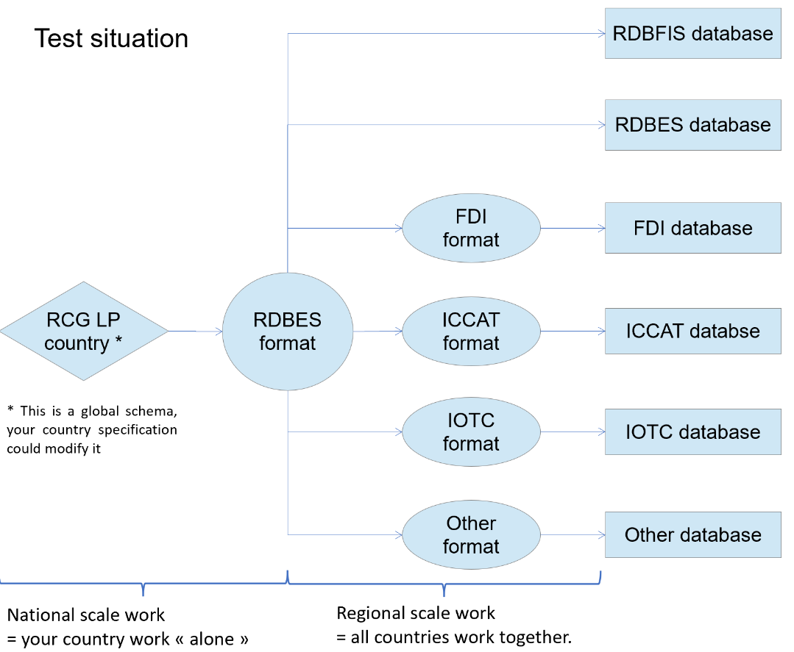
RDBFIS and Large Pelagic
1. Common RDB format & test

Slide 7
RDBFIS and Large Pelagic
2. LP database
Trip
Haul
Species composition
Morphometry
Maturity
Stomach content, prey
Age, rings

Slide 8
RDBFIS and Large Pelagic
3. ICCAT datacall
ST01-T1FC
TASK 1 - FLEET CHARACTERISTICS
ST02-T1NC
TASK 1- NOMINAL CATCHES
ST04-T2SZ_ALB
TASK 2 - SIZE SAMPLING (tunas and sharks)
ST03-T2CE_ALB
TASK 2 - CATCH AND EFFORT
ST04-T2SZ_BFT
TASK 2 - SIZE SAMPLING (tunas and sharks)
ST03-T2CE_BFT
TASK 2 - CATCH AND EFFORT
ST04-T2SZ_SWO
TASK 2 - SIZE SAMPLING (tunas and sharks)
ST03-T2CE_SWO
TASK 2 - CATCH AND EFFORT
ST09-DomObPrg
Task 3 - Domestic Observer's Programme

Slide 9

EASME/EMFF/2020/OP/0021
Specific Contract CINEA/EMFAF/2024/3.1/01/SC08
Establishment of the Regional Database for the Mediterranean and Black Seas
(RDBFIS-III, 01/04/2025 – 21/05/2026)
Project Coordinator: Dr. Irida Maina (HCMR)
Scientific Coordinator: Stefanos Kavadas

Slide 10
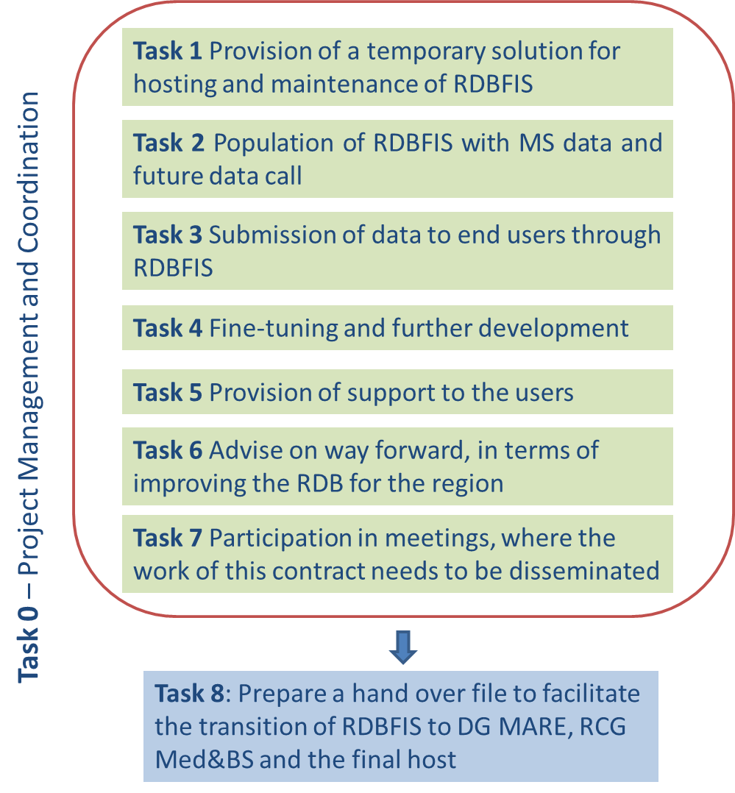
Med&BS RDBFIS-III
Project structure
Aim
Continue the hosting, maintenance, fine-tuning and further development of RDBFIS;
Finalize the population of RDBFIS with data (from existing data calls) and agree with the relevant actors on an all-encompassing data call for the future;
Work towards using RDBFIS for submission to the main data calls and reporting obligations;
Provide support to the users of RDBFIS and to ensure the migration to the permanent host once a decision is taken.
Sub-Task 0.1 – Project management
Sub-Task 0.2 – Meetings with CINEA/DG MARE
Sub-Task 0.3 – Reporting activities

Slide 11
TASK 4: Fine-tuning and further development of RDBFIS
1-Regional database maintenance and restructuring
S. Kavadas, I.Maina (HCMR)
M: 1-13
2- Update/revision of existing data quality tools
I.Bitetto, W. Zupa (COISPA)
M: 2 - 5
3-Development of data quality tools: MEDIAS
S.Kavadas, A.Kapelonis (HCMR), T. Hattab (Ifremer)
M: 2- 8
4-Further development & adjustments of tools4MCDA
I. Maina (HCMR), S.Kavadas
M: 8-1
5-Improvement & further development of the spatial visualization (mapping) component
I. Dokos , I.Maina (HCMR)
M:1 to 9
6- Improvement and further development of the existing validation scheme and consistency checks
S. Kavadas, I. Maina (HCMR), I. Chamodrakas(UOA)
M: 1 - 12
7-Fleet analysis (yearly updates), improvement of spatial checks for FDI
S. Kavadas, I. Chamodrakas (UOA)
M: 5 to 6
8-Integration of sampling optimization in RDBFIS
I. Bitetto W. Zupa (COISPA)
M: 1 to 12
9-Common raising procedures for the Med&BS biological data
M. Pantazi (HCMR), K. Touloumis (FRI)
M: 1 to 4
10-stat4RDBFIS software Package development
V. Sgardeli (HCMR), I. Costantini (CNR)
M: 4 to 12
11-Development of the MAPAFISH-MED tool
V. Sgardeli, D. Damalas (HCMR)
M: 2, 3, 12, 13
12-Fine-tuning
I. Chamodrakas (UoA), S. Kavadas, K. Kalkavouras (HCMR)
M: 1 to 13

